Slide 1

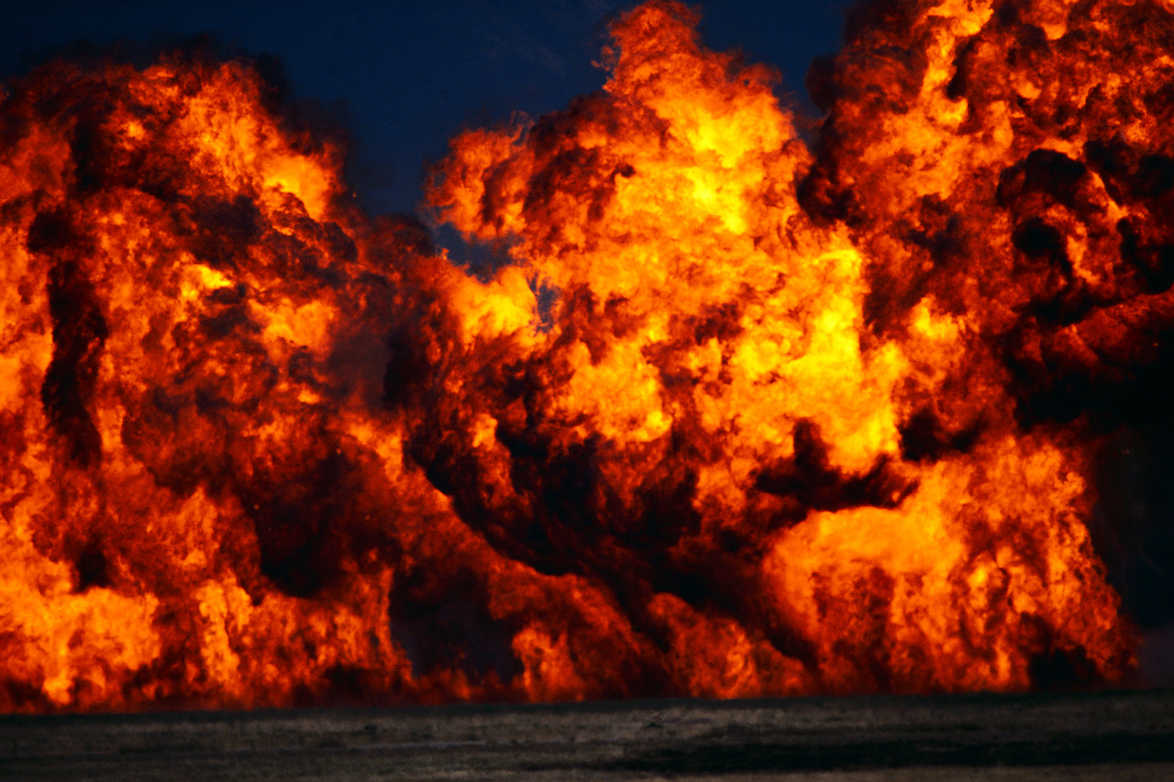
ALMOST LOST
“Now ‘If the righteous one is scarcely saved, where will the ungodly and the sinner appear?’” (1 Pet. 4:18)
All passages are from the NKJV unless noted
Notes:
Read 1 Peter 4:15-19
Deal with this in Lesson 2.

Slide 2
We Can Note People Who Were
“Almost Persuaded” (Acts 26:28)
Agrippa
Lot’s wife (Gen. 19:15-26)
Rich young ruler (Lk. 18:18-23)
Felix (Acts 24:24-27)
Rulers (Jn. 12:42)
Perhaps you have studied with people to find them only “almost” persuaded?

Slide 3
What About Those Who Were “Almost Lost?”
Does The Bible address individuals who were saved and almost lost their reward?
Calvinists say such is impossible
Christ says such is possible

Slide 4
What The Bible Teaches:
Luke 9:62
  “But Jesus said to him, ‘No one, having put his hand to the plow, and looking back, is fit for the kingdom of God’”
Revelation 3:11
  “Behold, I am coming quickly! Hold fast what you have, that no one may take your crown”
Hebrews 3:12
  “Beware, brethren, lest there be in any of you an evil heart of unbelief in departing from the living God”
Hebrews 4:1
  “Therefore, since a promise remains of entering His rest, let us fear lest any of you seem to have come short of it”

Slide 5
The Gift of Eternal Life Requires
“Patient Continuance” On Our Part
Romans 2:7, “eternal life to those who by patient continuance in doing good seek for glory, honor, and immortality”
Galatians 6:9, “And let us not grow weary while doing good, for in due season we shall reap if we do not lose heart”
2 Timothy 3:14, “But you must continue in the things which you have learned and been assured of, knowing from whom you have learned them”
Revelation 2:10, “…Be faithful until death, and I will give you the crown of life”

Slide 6
Some Were Saved And Then “Altogether Lost”
“having faith and a good conscience, which some having rejected, concerning the faith have suffered shipwreck, of whom are Hymenaeus and Alexander, whom I delivered to Satan that they may learn not to blaspheme” (1 Tim. 1:19, 20).
  They had a ship of faith that was later wrecked

Slide 7
Some Were Saved And Then “Altogether Lost”
“But I want to remind you, though you once knew this, that the Lord, having saved the people out of the land of Egypt, afterward destroyed those who did not believe” (Jude 5)
  They were saved, then destroyed
  The Lord is savior and destroyer

Slide 8
Some Were Saved And Then “Altogether Lost”
2 Peter 2:1, “But there were also false prophets among the people, even as there will be false teachers among you, who will secretly bring in destructive heresies, even denying the Lord who bought them, and bring on themselves swift destruction”
  They were bought by the Lord
  They then denied the Lord
  They were altogether lost

Slide 9
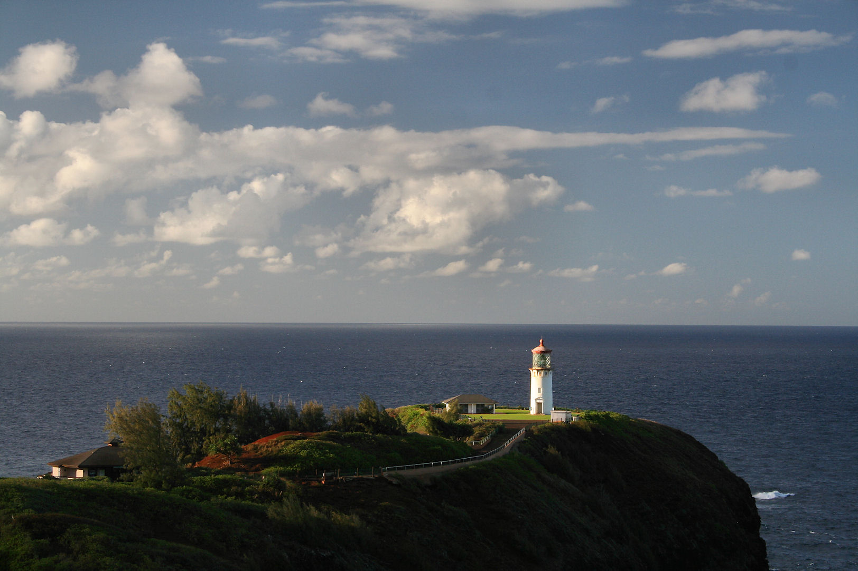
Asaph
Psalm 73
A Saint Who Nearly Slipped Away

Slide 10
Asaph
A Levite
Like David, skilled in music (2 Chron. 29:30)
Author of 12 Psalms (50, 73-83)
Nearly fell away
  Not because of worldliness
  Not because of a sensual temptation
  Not because of pride
  Because of an intellectual conflict

Slide 11
Psalm 73:1, 2
¹ Truly God is good to Israel, To such as are pure in heart. ² But as for me, my feet had almost stumbled; My steps had nearly slipped.
One can recognize that God is good and at the same time nearly slip away from Him
One could have walked with Christ and sat at His feet…yet His violent death could create sorrow and unbelief—despite evidence of an empty tomb (Lk. 24:17-26)
To avoid slippage, we must strive to look at situations from heaven’s viewpoint

Slide 12

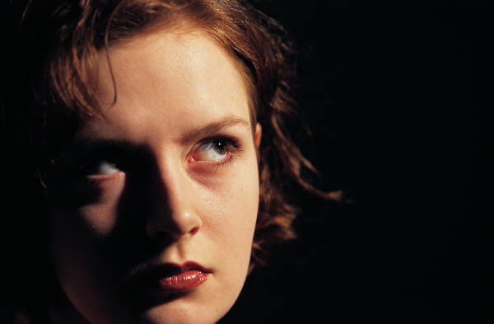
PSALM 73:3-16
Life’s Seemingly Injustice: A Saint’s Perplexity
The
Wicked
boastful
prosperous
proud
blasphemous
peace
First Temptation
73:3-12
Notes:
Asaph observed a peace and prosperity within the ranks of the wicked and thought that perhaps there was no real advantage of religion, that God perhaps befriended wicked men the same way He would righteous.
Envy began to fill Asaph’s heart. The arrogant boasting, the peace and absence of knots in their death and the fullness of prosperity of their lives presented a problem to Asaph’s understanding of living righteously.

Slide 13
Asaph’s Observation of the Wicked
Their great prosperity (73:3, 7)
Their seemingly lack of pangs (bands, YLT) in their death
  Their ease at death did not match the proportion of their wickedness
Their might is firm
  Their strength is strong and plentiful
Not in trouble/plagued (cf. 73:12)
  Ecclesiastes 7:15
Their pride for a necklace; violence for a garment
  “They seem to imagine that they are better than others, and that they are treated in this manner “because” they are better than others” (Barnes)
Their scoffing (mocking) (73:8, 9; cf. Rev. 13:6)
  Free course of their speech
Notes:
TROUBLED/PLAGUED -- “I have seen everything in my days of vanity: There is a just man who perishes in his righteousness, And there is a wicked man who prolongs life in his wickedness” (Eccl. 7:15).
Their life seems to be characterized by ease with the absence of trouble. Saints on the other hand are often found in trials of the flesh and of the spirit.
PRIDE/VIOLENCE – as we wear a garment to cover ourselves so these cover themselves with violence in their dealings. They have the power to silence their detractors and hence cover up their deeds and their accountability with violent acts.
SCOFF – Appreciate Asaph’s intellectual dilemma. The saint is to be careful with his actions and his tongue as he knows that even idle words can arise against him in judgment. The saint buffets his body and strives to bridle his tongue and yet, here the wicked are who conceal their wicked and evil ways with violent acts, who talk as if they are in heaven and yet at the same time against heaven. Their blasphemous tongue has no limits, no boundaries on earth and runs, rides and slides with free course.
The intellectual trap is, that if there is a God of righteousness who hates sin, arrogance and evil, then why are the most prosperous on God’s earth violent and blasphemous?

Slide 14
Parallel Perplexity
The Easy Life Of The Wicked
⁷ Why do the wicked live and become old, yes, become mighty in power? ⁸ Their descendants are established with them in their sight, and their offspring before their eyes. ⁹ Their houses are safe from fear, neither is the rod of God upon them. ¹⁰ Their bull breeds without failure; their cow calves without miscarriage. ¹¹ They send forth their little ones like a flock, and their children dance. ¹² They sing to the tambourine and harp, and rejoice to the sound of the flute. ¹³ They spend their days in wealth, and in a moment go down to the grave. ¹⁴ Yet they say to God, ‘Depart from us, for we do not desire the knowledge of Your ways. ¹⁵ Who is the Almighty, that we should serve Him? And what profit do we have if we pray to Him?’
Job 21:7-15

Slide 15
PSALM 73:3-16
Life’s Seemingly Injustice: A Saint’s Perplexity
The
Righteous
Plagued all day long
Chastened every morning
Second Temptation
73:13, 14
What is the practical benefit of being righteous?

Slide 16
HUMAN Reasoning
“And is there knowledge in the Most High?” (73:11)
  Can there be a righteous omniscient God who knows evil is at work and does not stop it?
  Can there be goodness in an omniscient God who sees evil is directed to saints and does not thwart it?
    Conclusion:
    If God is all knowing then how can He allow evil to exist?
    If God is good why would he allow evil to run its course?
    God must either not be omniscient or He must not be good.

Slide 17

HUMAN Reasoning
Its effect on Asaph: “Surely I have cleansed my heart in vain, and washed my hands in innocence” (Ps. 73:13)
  The wicked seem to be blessed more than the righteous; the righteous seem to have more sorrow than the wicked
  Living a life that pursues holiness and purity does not obtain the favor from heaven
  I would have been better off living a life gratifying the senses and taking the world as my lot

Slide 18
BIBLICALLY BASED Reasoning
“Surely I have cleansed my heart in vain, And washed my hands in innocence” (Ps. 73:13)
  The previous reasoning assumes suffering to be evil and receiving good things as being righteous
  Those outside of Christ will look at the problems of faith to “excuse” themselves from faith
  Those inside of Christ may become perplexed by the problems of faith and fall away…or pursue and pray for answers
  Must recognize that we walk by faith and not absolute certainty
  (2 Cor. 5:7)
    Belief and unbelief can be at work at the same time (Mk. 9:23, 24)
    With faith we should always seek to increase our faith

Slide 19
Biblical Perspective and Human Reasoning
It is not that a Biblical perspective is without a human reasonableness…human but not only human
  It originates from a source higher than mere humanism
  Purely human construction/outlook versus a biblically guided outlook
The Biblical Perspective Versus The Humanistic:
“If, in the manner of men, I have fought with beasts at Ephesus, what advantage is it to me? If the dead do not rise, ‘Let us eat and drink, for tomorrow we die!’” (1 Cor. 15:32)
  If the dead do not rise, then “eating and drinking” (living for today) would be a reasonable pursuit
  But if the dead do rise, it is advantageous to even fight beasts in the Ephesus theater if it is because of Christ the Lord

Slide 20
“For all day long I have been plagued, And chastened every morning” (Ps. 73:14)
God’s religion for man is not without pain and suffering
  Job, Jeremiah, Jesus, etc. …
  God’s grace is not “cheap grace” and the faith is not a “cake walk”
    “And whoever does not bear his cross and come after Me cannot be My disciple” (Lk. 14:27)
  The “health and wealth gospel” cheapens the character of our God and His gospel
  The “health and wealth gospel” promotes the mindset of Psalm 73:13, 14

Slide 21
How do we fare when we drink the bitter cup of life?
When the ungodly flourish?
When the godly suffer?
When sin enters the camp?
When Christians we look up to fail?
When sorrow or suffering comes upon us?

Slide 22
The Biblical Perspective
“that you may be sons of your Father in heaven; for He makes His sun rise on the evil and on the good, and sends rain on the just and on the unjust” (Matt. 5:45)
Even when there is great injustice in life, God does care for you and will exalt you in due time (1 Pet. 5:5, 6)
God’s will needs to be done and your suffering doesn’t always equate divine displeasure (Is. 53:10, 11)
  “Fear not, for I am with you; Be not dismayed, for I am your God. I will strengthen you, Yes, I will help you, I will uphold you with My righteous right hand” (Is. 41:10)
Sometimes the wages of holiness cost coins of affliction
  “Before I was afflicted I went astray, But now I keep Your word” (Ps. 119:67; Jas. 1:3)
All have the choice to stay with God and His people or walk away in trial (Mk. 10:21, 22)
Notes:
“For our light affliction, which is but for a moment, is working for us a far more exceeding and eternal weight of glory” (2 Cor. 4:17)

Slide 23
ALMOST LOST
Allurements
Adversities
Lesson 2
“Now ‘If the righteous one is scarcely saved, where will the ungodly and the sinner appear?’” (1 Pet. 4:18)
Notes:
Read 1 Peter 4:15-19
ADVERSITIES- This was the immediate threat that Peter had just dealt with (see 4:12-17). It is referred to as a judgment of sorts because God allows these trials to come upon the righteous so that they may pass through them. Some suffering is self-inflicted and deserved (v. 15; cf. 1 Pet. 2:20).
Other suffering may occur for doing what is right (v. 16, 17). This can be a form of trial by fire to purge us. It is also something that many Christians may fall from the faith in. The solution to this is found in 4:19.
ALLUREMENTS – were addressed in 4:1-5 (note: lusts of men). The things listed here are motivated by various lusts warring on our minds.
The solution is two-fold: 1. “cease from sin” (1 Pet. 4:1). It doesn’t say “debate with sin,” “reason with sin,” “compromise a little with sin,” “strategize with sin,” “redefine sin,” or “see how close you can get to it without sinning,” etc. But “cease from sin.” Desist! It is a war, not a game. When I think of how we ought to deal with sin, I think of Samuel and Agag (see 1 Sam. 15:1-3, 7-9, 13-20, 27-33). That is how we need to deal with sin. We need to hack it to pieces. It is a war. Compare Colossians 3:5-10.
2. Positively live for the will of God (1 Pet. 4:2). Live for Jesus. A new look, a new will with new goals and a new life.

Slide 24
ALMOST LOST
Allurements
Adversities
Lesson 2
“Now ‘If the righteous one is scarcely saved, where will the ungodly and the sinner appear?’” (1 Pet. 4:18)
Traps &
Distractions
Detours
Notes:
TRAPS & DETOURS: While these may be sexual traps, I have more in mind intellectual ensnarement's. Asaph nearly slipped not because of a sexual temptation or a worldly pursuit, but because of an intellectual conflict (see charts 12, 13, 15). Paul had to call people back to what was known rather than pursuing things that were the fruit and conniving of men’s thinking (Col. 2:18-3:2). False doctrine is a detour that leads many away from salvation and hence when the righteous walk through the challenges of such they are scarcely saved (2 Pet. 2:1-3). Paul seems to hint at a kind of detour in the internal struggle that he addressed in Romans 7:15-25. The solution to dealing with overcoming sin is found in only one place: the gospel of Jesus Christ.
DISTRACTIONS – Dis (away) tract (draw or pull); these are things that come in to play so that we take our eyes off of the goal or forget about why we are doing what we are doing and eventually go into another direction. Encarta defines, “something that interferes with concentration or takes attention away from something else.”
Lot’s wife became distracted with what she was leaving behind and did not keep looking forward. Saul in the 1 Sam. 13:11-13 became distracted and took his eyes off of the commandments of God. Our Lord warns to not be distracted in worrying about what we shall wear, eat and drink but to seek first the kingdom of God (Matt. 6:31-33). People in the pursuit of making a living often lose sight of living the life and responsibility that God demands of them. Some seem to teach that getting married and having children can be a distraction but actually, from a biblical point of view, not having children can become a distraction (1 Tim. 2:15; 5:11-14). The rich are commanded to not get distracted by riches (1 Tim. 6:17).
Hence there are many traps in this life that present themselves before us that may cheat us of our reward if we are not careful. The righteous one is scarcely saved because of all the traps, allurements and detours that come his way.

Slide 25
Because Of The Various Pitfalls For The Soul, We Need To:
Gird up (1 Pet. 1:13)
Be thankful when we are admonished and instructed rather than speak evil (2 Pet. 2:10, 16)
Resist the Devil (1 Pet. 5:8, 9)
Be alert of self-departure (2 Pet. 3:17)
Be diligent to grow (2 Pet. 3:18; 1:5-11)

Slide 26
The Hidden Reality (Ps. 73:17-22)
“Until I went into the sanctuary of God; Then I understood their end” (73:17)
What is seen is not lasting; what is not seen is eternal (Heb. 11:1-3)
  The observable universe was made by unobservable processes/power
  Things may look in a way in which they are not
  Those walking detached from God may appear confident and without trouble and yet be consumed in terror in a moment’s notice
  May look established and yet are standing on slippery places
A reality hidden from men but revealed by God
  The reality of God’s power and providence
  The reality of judgment and the end
Notes:
We have a turning point in the life of the Psalmist which begins in this verse.
1. Asaph sees more clearly only when he comes into the sanctuary of the Lord, only when he allows the Lord to be his schoolmaster. Before this, he didn’t see enough to make a proper judgment.
2. He only saw the present strength of the wicked but not their end. He didn’t see their end until he saw God’s control.

Slide 27
The Self-Recognition From Revealed Reality
(Ps. 73:21, 22)
“Thus my heart was grieved, and I was pricked in my reins” (Ps. 73:21, KJV)
  “When my heart was embittered and I was pierced within” (NASB)
  Revealed truth should grieve our heart and vex our minds
  Reveals how foolish we thought, talked and walked
“I was so foolish and ignorant; I was like a beast before You” (Ps. 73:22)
  “…A beast I have been with Thee” (YLT)
  Beasts move around by instinct and are often driven by natural impulses, not necessarily sensibility
Notes:
73:21: Asaph’s expression is interesting. The reality that Asaph found in the sanctuary had a strong effect on him. “Reins” here often means organs and is often translated kidney in the KJV. He is clearly speaking about his emotional self. It was like God’s word punched his thinking in the kidneys and battered his mind. He realized how foolish he was.
73:22: I was foolish, I had no correct views of life and the seemingly ease of the wicked. To prove this I took my dog (tabbi) and threw a ball or stick over a 15 foot cliff to see what she would do. She went over the cliff leaving visible claw marks down the edge. Such is the senselessness of acting like beasts. We see something that looks fun and run to it without considering, is this dangerous, right, wrong, consequential?

Slide 28
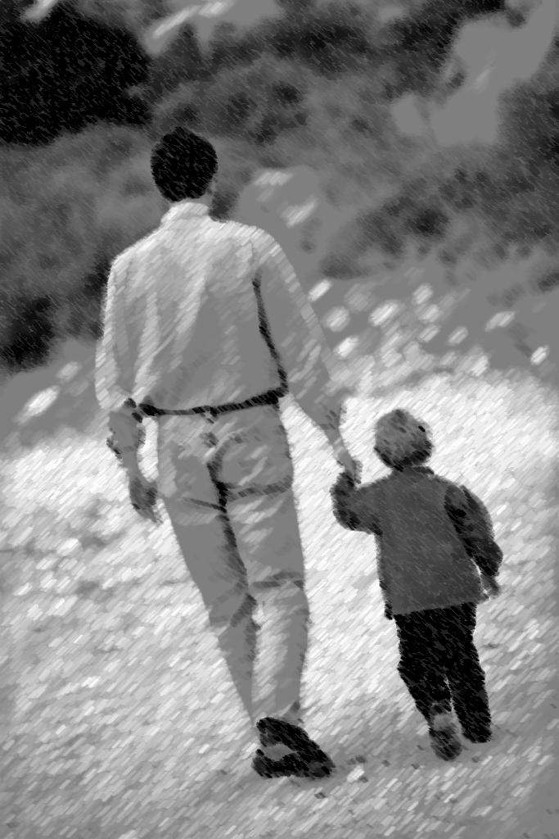
The Restriction and Reward From This Reality
“Nevertheless I am continually with You; You hold me by my right hand. You will guide me with Your counsel, And afterward receive me to glory” (Ps. 73:23, 24)
  He nearly slipped and fell away, but God was holding him by the hand
  Our thoughts about God could make God angry enough to banish us, but He continually guides
  Will we let loose of His hand (Jn. 6:66-69)?
    To what shall we cling?
    If we want glory, we must hold to His hand!
Notes:
God’s counsel gives us boundaries and is corrective. We may be like loved dogs who are fenced in and are not allowed to run throughout the creation. We may think that fence is not fair. We may think other dogs can run freely, chase cats, and walk around like they own the world. But we do not often appreciate that those boundaries are for our own safety and security.
Children learn to trust their father. They learn to trust him when he first helped them take their first step, when they were caught up in a tree and rescued, when they broke something and he fixed it, etc. As they grow older, they may be tempted to not trust him and begin to think he was not as wise or as strong as they once thought. They may begin to question his teaching. They may begin to think they know more about life than he does despite the fact that he has lived decades longer. Then later on in life they may mature and come back to an understanding of just how little they knew about life when they thought they knew so much. They began to realize that their father may have known a lot more than they wanted to give him credit for.
This is also a stage that newborn babes in Christ may go through. They start out trusting and then their curiosity of the world may drive them away from his unchanging hand. The quicker we are convinced that God always knows best, the easier and better our life will be.

Slide 29
The Resolve From This Reality: Draw Near!
“Whom have I in heaven but You? And there is none upon earth that I desire besides You. My flesh and my heart fail; But God is the strength of my heart and my portion forever. For indeed, those who are far from You shall perish; You have destroyed all those who desert You for harlotry. But it is good for me to draw near to God; I have put my trust in the Lord GOD, That I may declare all Your works” (Ps. 73:25-28)
  Saints can desert God because some have
  Asaph’s resolve was not to desert but draw near
  This resolve produced another: to declare all of God’s works!
Notes:
Note a relationship here in verse 28— “trust” and “declare.” There is a strong relationship that exist between those two words. The latter is a barometer of the former. If we find ourselves not declaring the works of God, it is probably because we are not trusting.

Slide 30
What Asaph’s Life Teaches
“Do not be overcome by evil, but overcome evil with good” (Rom. 12:21)
    Let’s apply in Life’s Challenges
Notes:
How might we apply these today.

Slide 31

Require extra care
Guard against losing your soul
  Even in trying to save the lost
  Envy not the wicked
  Pursue contentment and dependence upon God
  Be thankful every day for God’s favor (1 Tim. 1:12)
  Do not uphold and support those in error
  (Eph. 5:11)
  Constantly examine self (2 Cor. 13:5; Gal. 6:1)
  Do not receive an accusation against another without sufficient proof (1 Tim. 5:19)
Notes:
ENVY
Psalm 73:3, “For I was envious of the boastful, When I saw the prosperity of the wicked.”
Proverbs 24:1, “Do not be envious of evil men, Nor desire to be with them”
CONTENTMENT
Moses in exile found a wife through contentment though living in a strange land (Ex. 2:21)
Paul found contentment in whatever state he found himself in (Phil. 4:11). That is a pretty amazing thing and a goal for all men to pursue. Contentment is tied with thanksgiving and makes whatever condition you are in better. Solomon said, “Better is a little with the fear of the LORD, Than great treasure with trouble” (Prov. 15:16). The irony is that when contentment wanes, then trouble begins! Paul explained that godliness with contentment is great gain (1 Tim. 6:6). Do you know that most people have the capacity to reach this goal. Heb 13:5 , “Let your conduct be without covetousness; be content with such things as you have. For He Himself has said, "I will never leave you nor forsake you.“ Covetousness is the opposite of being content.
UPHOLDING THOSE IN ERROR– (Eph. 5:11); It is for your own good and for the good of those who have sinned and have not repented to withdraw fellowship. When you eat, drink and have fun with those who have not repented, you share in their deeds and do nothing to cause them to rethink their actions. It is never easy to divorce yourself from those who propelled error, especially those who previously held your heart in their hands (1 Sam. 15:34, 35). This will be more along the subject line in next week’s lesson.

Slide 32
If the wicked are prosperous, hope that they may see God in their prosperity; it may be the only joy they ever experience otherwise (Lk. 16:19-23)
If brethren leave the church, do not blame God; pray they come to their senses (2 Tim. 2:26)
No need to constantly run interference with slanders (Ps. 31:13-18; 101:5)
  If someone loves to talk about you to others, let your own life’s record speak for itself
  Recognize the small-minded talk about people when they are not present; the weak-minded hear it; the spiritually minded talk about God and how to be effective in the gospel’s work
  What do those you love to hang around love to talk about?
Notes:
Gossip and slander have never been so easy to engage in as it is today. People can jump in their cars and be at another person’s house in moments; they can pick up the phone, send out a message on FB or email that fishes and lures others into gossip where they can slander another person’s name. It is still just as sinful as it has always been. The interface doesn’t make it anymore acceptable. It will still land a person in the eternal flames of hell if they do not repent.
Psalm 31:13-18; notice the “I hear the slander of many.” The ironic thing about slanderers is that when they slander one, they think he doesn’t hear. But it usually makes it way back to the person they injured with their mouth. Do not slip away from God when people slander you. A future lesson will deal with this subject in more detail.
If someone yearns to hear and believe gossip about you without talking to you, they are weak-minded as well

Slide 33
If brethren are worldly, pray that their pursuit of the world will afflict their souls so that they may repent and run to the word
Correct those who promote erroneous and flawed doctrines and do not get off task
  refrain from making it a personal confrontation
  let the chips fall where they may
  those who love truth will love you; those who hate truth will run from you, if you hold the truth
Overcompensate physical adversity with the spirit (2 Cor. 4:16; 12:10)

Slide 34
What Is Your Resolve Regarding The Reality of God?
25 Whom have I in heaven but You? And there is none upon earth that I desire besides You.
26 My flesh and my heart fail; But God is the strength of my heart and my portion forever.
27 For indeed, those who are far from You shall perish; You have destroyed all those who desert You for harlotry.
28 But it is good for me to draw near to God; I have put my trust in the Lord GOD, That I may declare all Your works.
Psalm 73

Slide 35
Psalm 84:10
“For a day in Your courts is better than a thousand. I would rather be a doorkeeper in the house of my God Than dwell in the tents of wickedness.”

Slide 36
Jehoshaphat
Struggled Over Fellowship With Darkness

Slide 37
Jehoshaphat
Why was the LORD with him?
  Walked former ways
  Did not seek the Baals
  Sought the God
  Walked in His Commandments
  Therefore
  All Judah gave
  Took delight/ removed
2Ch 17:3-6, “Now the LORD was with Jehoshaphat, because he walked in the former ways of his father David; he did not seek the Baals, but sought the God of his father, and walked in His commandments and not according to the acts of Israel. Therefore the LORD established the kingdom in his hand; and all Judah gave presents to Jehoshaphat, and he had riches and honor in abundance. And his heart took delight in the ways of the LORD; moreover he removed the high places and wooden images from Judah”
Notes:
WALKED FORMER WAYS--Jeremiah 6:16. Should we not be like Jehoshaphat and ask for the old ways? The ancient path of righteousness should attract us as it did this king.
HE DID NOT SEEK THE BAALS—The Baals were the false gods that Israel worshiped. These were the inventions of men’s thinking as Baal was not a real god. It may have been more entice, more fun, more exciting, but it had no draw upon this king.
HE SOUGHT THE GOD OF HIS FATHER. He sought the true God and not the false made up ones. He recognized that God’s way was the right way and that Jehoshaphat and his country needed Jehovah’s approval to be successful. But first Jehoshaphat needed to first get his own life in order before he could be influential on his country.
NOTICE HE WALKED ACCORDING TO HIS COMMANDMENTS and not the acts of Israel. We see two things pertaining to walking the line. Jehoshaphat in choosing to walk according to the commandments of God knew that he could not walk along the acts of Israel. They worshipped the golden calves and so Jehoshaphat rightly understood that keeping God’s commandments excluded a walk like His northern brethren and their false religion. He would have to later learn that this would also entail not supporting their hands.
Walking with God requires that we walk in His commandments.
Ps 86:11 Teach me Your way, O LORD; I will walk in Your truth; Unite my heart to fear Your name.
2Jo 1:4 I rejoiced greatly that I have found some of your children walking in truth, as we received commandment from the Father.
THEREFORE--The LORD established the kingdom in his hand. Why did the Lord establish his kingdom? How was the kingdom established? Not by might, military, or economic success, but by his choice to walk in the commandments of God (Prov. 14:34). “He also brought me up out of a horrible pit, Out of the miry clay, And set my feet upon a rock, And established my steps” (Ps. 40:2).
But God seeks to establish us today too. The early church was going to be faced with lying wonders and acts of deception but they could be established by God in the gospel (2 Thess. 2:16, 17; 1 Thess. 3:2, 13).
ALL JUDAH GAVE--Jehoshaphat received honor and presents from his fellow countrymen. He was well received and we might make one observation that receiving gifts and earthly riches is not necessarily a negative. It is negative when we are led by our possessions. Receiving them and ruling over them is not the danger, but coveting and doing so much to apprehend them at the expense of other duties is what becomes dangerous. We are the only creatures created who actually own things and with that comes responsibility. The amplification of wealth and fame became the ruin of Uzziah but not Jehoshaphat (2 Chron. 26:16).
TOOK DELIGHT—Note the relationship that taking delight in the ways of God requires removal of wickedness (cf. Jas. 1:21).

Slide 38
Jehoshaphat
A great man and often an under appreciated king
Respected and valued those who taught the law of God (commissioned: 2 Chron. 17:7-9)
Commanded judges to judge in the fear of the Lord (2 Chron. 19:4-9)
  The LORD, who is with you in judgment
When attacked, he trusted in God and gained victory (2 Chron. 20:1-30)
Notes:
2 Chron. 17:9 – reminds me of King Jesus sending out the disciples to teach the people of Judah (Mk. 6:7-13). It is interesting that Jehoshaphat wanted to walk in the ways of God and wanted to promote that the people do the same. These Levites went out with two priests and officers for that very purpose. The people needed to be trained and taught the Law. God’s word is always in need to be taught. God’s word is always good for a country to hear.
This clearly displays before our eyes that righteousness exalts a nation. Notice again how it was not the economy, not the wealth, not the political system, not the military might, but fundamentally the fear of God that exalted this nation (read 2 Chron. 17:10-13). America needs to learn the lessons of the Bible and refocus our minds on where the problem is. We are trying to fix the symptom and ignoring the cause and the solution. We need to get back to God. People need to get back to studying the Bible and looking for the Lord’s place to worship. We need to get back to seeking to walk with God, extend mercy to our neighbors and uphold the justice of God and the rule of law. A nation without law is a nation without order. When these things are corrected then other things can fall into place.
2 Chron. 19:4-9
Jehoshaphat had been previously reproved and after such, he did not sulk or get so irate that he needed a cooling off period, but went out and spent time among the people to reclaim them. They may have looked at his example of mingling with Ahab as reason enough to forsake the LORD and join up with false gods again. That is an example of repentance.
He also seems to make a fresh appointment of judges in the land as corruption may have seeped in. What follows is his admonition of the judges.
THE LORD IS WITH YOU –is how you should judge. We are called to temper ourselves with the thought that the LORD is near (Jas. 5:9).
Verse 6 is so applicable that judges should judge for the Lord and not for men. Likewise preachers need to preach to please the Lord and not men (Gal. 1:10). Adam Clarke observed, “A very solemn and very necessary caution; judges should feel themselves in the place of God, and judge as those who know they shall be judged for their judgments.”

Slide 39
“…as they went out, Jehoshaphat stood and said, ‘Hear me, O Judah and you inhabitants of Jerusalem: Believe in the LORD your God, and you shall be established; believe His prophets, and you shall prosper’” (2 Chron. 20:20)
Believe in God
+
Believe in Prophets
(Go Down Against)
= Established and Prosper
Believe
+
Baptism
(Go Down In Water)
= Be Saved
“He who believes and is baptized will be saved…” (Mk. 16:16)
“But without faith it is impossible to please Him…” (Heb. 11:6)

Slide 40

Association/Alliance With the Workers of Wickedness
  “Jehoshaphat had riches and honor in abundance; and by marriage he allied himself with Ahab” (2 Chron. 18:1)
“And have no fellowship with the unfruitful works of darkness, but rather expose them” (Eph. 5:11)
Notes:
His son married Ahab’s daughter. I have pitfall in the singular because scripture bears out that this was his one challenge. A desire to be yoked with brethren who were untruthful and walking contraire to Jehovah.
You know it is really just that way. We may think there are many complicated challenges in our life to over come, but if you stop and really think about the things that challenge you to loose your reward, it really boils down to just one or two things, primarily. It is not a list of things. There is usually one root problem within that is causing the problem and it is that root that must be identified and soberly dealt with. It is that one root that must be severed. For the rich young ruler it was materialism. For David and Solomon it may have been self-control. For Jehoshaphat it was keeping company with unfaithful brethren.
This is the real underappreciated thing about removing your fellowship from those who would transgress God’s law: it maintains a safeguard not only against you from being unduly influenced by transgressors, but it also can safeguard your children. You might think. Well I can do things with them without being influenced by the.
Say they are a gossip. You don’t know that you won’t be influenced to gossip and the slanderous misinformation that was delivered to you can remain in your mind forever against the person that was slandered. You might think that a brother or sister’s loose views regarding drinking, dancing and modesty will not influence you to drink, dance or dress immodestly. But as you socialize and mix your time with them, they will most definitely have an effect of influence upon your children and that influence may last for years and even for generations.

Slide 41
WARNINGS From His Ancestors
Ps. 1:1, “Blessed is the man Who walks not in the counsel of the ungodly, Nor stands in the path of sinners, Nor sits in the seat of the scornful”
Prov. 1:15, “My son, do not walk in the way with them, Keep your foot from their path”
Prov. 4:14, “Do not enter the path of the wicked, And do not walk in the way of evil.”
Prov. 24:1 “Do not be envious of evil men, Nor desire to be with them”

Slide 42
Association/Alliance With the Workers of Wickedness
  “Jehoshaphat had riches and honor in abundance; and by marriage he allied himself with Ahab” (2 Chron. 18:1)
    Son, Jehoram, married Ahab’s daughter, Athaliah
    This compromise would result in all kinds of heartbreak and unrest for many years even after Jehoshaphat’s death
    Jehoshaphat’s failure in this one area is an open commentary on, “Do not be deceived: ‘Evil company corrupts good habits’“ (1 Cor. 15:33)

Slide 43
    “Do not be deceived: ‘Evil [2556] company corrupts good habits’“ (1 Cor. 15:33)
EVIL?
  Can simply be that which is not as it ought to be
  The wrong mode of thinking; the wrong feeling, the wrong action
  Can also be troublesome, injurious and destructive
  “frequently means evil rather negatively, referring to the absence of the qualities which constitute a person or thing what it should be or what it claims to be. It is also used meaning evil in a moral sense” (Online Bible Greek Lexicon)
  There is another word [4190] for greater intensity and which “evil” denotes delighting in mischievous, wicked and destructive ways

Slide 44
    “Do not be deceived: ‘Evil [2556] company corrupts good habits’“ (1 Cor. 15:33)
EVIL?
  The viper that bites does harm (evil), but it doesn’t do so with delight.
  “But when Paul had gathered a bundle of sticks and laid them on the fire, a viper came out because of the heat, and fastened on his hand. …But he shook off the creature into the fire and suffered no harm [2556]” (Acts 28:3, 5)

Slide 45
    “Do not be deceived: ‘Evil [2556] company corrupts good habits’“ (1 Cor. 15:33)
“EVIL” – Something that can be hard to discern as evil unless you are a mature and full age thinking Christian
  “But solid food belongs to those who are of full age, that is, those who by reason of use have their senses exercised to discern both good and evil” (Heb. 4:14)
  Not all evil is easy to see from a human perspective
  A “grey” area to one may be considered “evil” to God

Slide 46
    “Do not be deceived: ‘Evil [2556] company corrupts good habits’“ (1 Cor. 15:33)
“EVIL” – The antithesis of “faithful and wise”
  “Who then is a faithful and wise servant, whom his master made ruler over his household, to give them food in due season? Blessed is that servant whom his master, when he comes, will find so doing. Assuredly, I say to you that he will make him ruler over all his goods. But if that evil servant says in his heart, ‘My master is delaying his coming,’ and begins to beat his fellow servants, and to eat and drink with the drunkards, the master of that servant will come on a day when he is not looking for him and at an hour that he is not aware of, and will cut him in two and appoint him his portion with the hypocrites. There shall be weeping and gnashing of teeth” (Matt. 24:45-51)

Slide 47
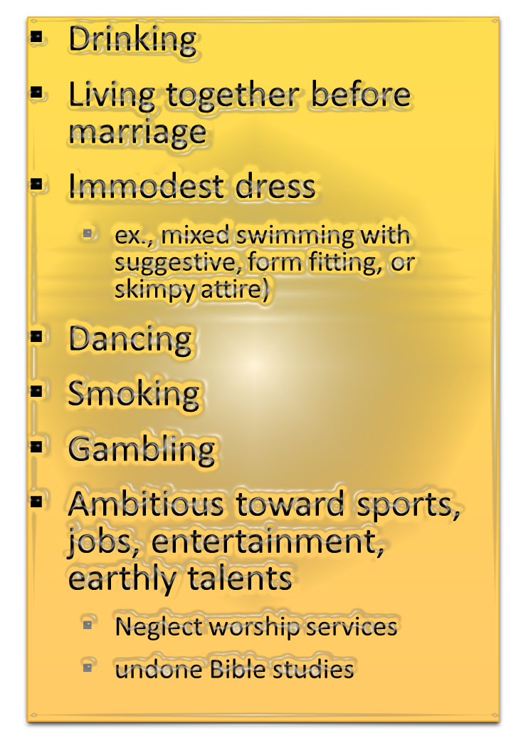
Applications
Beating up the faithful with unjustified words and eating and drinking with the unfaithful is “evil”
Engaging in any behavior that is not appropriate for Christ is “evil”

Slide 48
Concise Bible Dictionary Regarding Athaliah (Jehoshaphat’s daughter-in-law)
“Daughter of Jezebel and Ahab, and granddaughter of Omri (cf. 2Ki 8:26 with 2Ki 8:18), wife of Jehoram king of Judah. She may be said to have introduced the worship of Baal into Judah, and she brought up her son to follow in her evil ways. 2Ch 22:3. He having been slain by Jehu when he was executing judgment on the house of Ahab, Athaliah usurped the throne and endeavoured to destroy all the seed royal. One child, Joash, was concealed in the temple, and after Athaliah had reigned six years, he was anointed king and crowned; Athaliah was taken outside the enclosures of the temple and slain, B. C. 878. The temple and idol of Baal were at once destroyed, and the priest slain. The history is a solemn instance of the danger of an unholy alliance. 2Ki 11:1-20 2Ch 23:12-21.”

Slide 49
A Good Man Who Desired Fellowship With DARKNESS!
Was taken in by the hospitality of the wicked
  The FUN/BAIT: “After some years he went down to visit Ahab in Samaria; and Ahab killed sheep and oxen in abundance for him and the people who were with him…” (2 Chron. 18:2).
    “Ahab” must be for “Abundance” of fun
    The wicked can behave in kindness to further a work of sin
    The righteous can be attracted more to the kindness, fun, flattery, and entertaining quality of a person rather than the attribute of righteousness

Slide 50
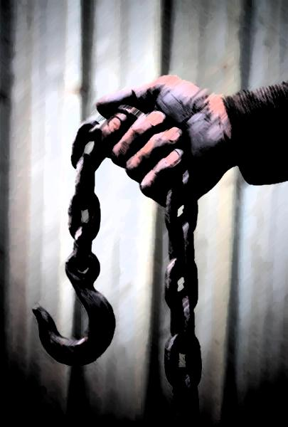
A Good Man Who Desired Fellowship With DARKNESS!
Was taken in by the hospitality of the wicked
  The HOOK… “and persuaded him to go up with him to Ramoth Gilead. So Ahab king of Israel said to Jehoshaphat king of Judah, ‘Will you go with me against Ramoth Gilead?’ And he answered him, ‘I am as you are, and my people as your people; we will be with you in the war’”
  (2 Chron. 18:2, 3).
Notes:
Make no mistake about it. If Ahab could persuade Jehoshaphat to go to war, then those who are not walking the line can influence you to not walk the line as well.

Slide 51
A Good Man Who Desired Fellowship With DARKNESS!
Was taken in by the hospitality of the wicked
  Intimacy between Jehoshaphat and Ahab as seen in:
    Son in marriage to Ahab’s daughter
    Willingness to fight beside each other, “I am as you are, and my people as your people; we will be with you in the war”
    The naming of the children

Slide 52
A Good Man Who Desired Fellowship With DARKNESS!
Was taken in by the hospitality of the wicked
Jehoshaphat’s compromise provided a portal for Ahab’s darkness into his household
Notes:
Sin and the bungee cord. “Pr 5:22 His own iniquities entrap the wicked man, And he is caught in the cords of his sin.”

Slide 53

“I am as you are, my people as your people” (1 Kin. 22:4)
Ahab & Jezebel
Jehoram
Jehoshaphat & Wife
Ahaziah
Jehoram
Athaliah
Ahaziah
ISRAEL’S KING
JUDAH’S KING
Fatal Attraction
2 Chronicles 21:1-20
Was the fellowship and fun with Ahab worth it?
Notes:
Was it worth it?

Slide 54
“I am as you are, my people as your people” (1 Kin. 22:4)
ISRAEL
JUDAH
Ahab & Jezebel
Jehoram
Jehoshaphat & Wife
Ahaziah
Jehoram
Athaliah
Ahaziah
Fatal Attraction
2 Kings 8:26, 27
“He also walked in the ways of the house of Ahab, for his mother advised him to do wickedly. Therefore he did evil in the sight of the LORD, like the house of Ahab; for they were his counselors after the death of his father, to his destruction” (2 Chron. 22:3, 4)
Notes:
Was it worth it????

Slide 55

Ahab’s Darkness Flowed Into Jehoshaphat’s House
“I am as you are, my people as your people”
ISRAEL
JUDAH
Ahab & Jezebel
Jehoram
Jehoshaphat & Wife
Ahaziah
Jehoram
Athaliah
Ahaziah
Jehoshabeath
Joash
Fatal Attraction
2 Chron. 22:8-12
saved
Notes:
Was it worth it? NO!

Slide 56
Jehoshaphat’s Fellowship With Ahab
Plagued the nation and His family for 15 years with false religion
Countless killings and the near annihilation of his grandchildren by Jehu and his daughter-in-law
The Ungodly Reign
  Jehoram (8 years)
  Ahaziah (1 year)
  Athaliah (6 years)
“Do not be deceived, God is not mocked; for whatever a man sows, that he will also reap” (Gal. 6:7)

Slide 57
A Good Man Who Desired Fellowship With DARKNESS!
Was taken in by the hospitality of the wicked
Jehoshaphat’s compromise provided Ahab’s darkness an opening into his household
Almost died…placed in grave physical danger because of this alliance (2 Chron. 18:28-34)
Was rebuked for his transgression
  “Then Jehoshaphat the king of Judah returned safely to his house in Jerusalem. And Jehu the son of Hanani the seer went out to meet him, and said to King Jehoshaphat, ‘Should you help the wicked and love those who hate the LORD? Therefore the wrath of the LORD is upon you’” (2 Chron. 19:1, 2)

Slide 58
Jehu’s Question
“Should you help the wicked and love those who hate the LORD?”
  “And have no fellowship with the unfruitful works of darkness, but rather expose them” (Eph. 5:11)
  “Through Your precepts I get understanding; Therefore I hate every false way” (Ps. 119:104)
  “And he went out to meet Asa, and said to him: ‘Hear me, Asa, and all Judah and Benjamin. The LORD is with you while you are with Him. If you seek Him, He will be found by you; but if you forsake Him, He will forsake you’” (2 Chron. 15:2)

Slide 59
Jehu the Son of Hanani
Was a prophet in the North who rebuked Baasha 35 years previously (Barnes)
Rebuked the evil and encouraged the good works of Jehoshaphat (2 Chron. 19:3, the wise rebuker Ps. 25:12)
Became a historian regarding Jehoshaphat (2 Chron. 20:34)

Slide 60
Jehu the Son of Hanani
“O LORD, are not Your eyes on the truth? You have stricken them, But they have not grieved; You have consumed them, But they have refused to receive correction. They have made their faces harder than rock; They have refused to return” (Jer. 5:3)
Obviously had a deep appreciation for the king and rebuked him from the motive of love
  Had he not rebuked, he would not have had love for Jehoshaphat’s soul (ignoring a known problem is “evil”)
  Jehoshaphat never engendered hatred for his rebuke but went about leading people back to Jehovah who may have strayed from his poor example—the display of true repentance (2 Kin. 19:4)
    “But when we are judged, we are chastened by the Lord, that we may not be condemned with the world” (1 Cor. 11:32; contrast Jer. 5:3)
Notes:
Jehu did not hate Jehoshaphat. He loved the good traits in him and wanted to wrote a book about this great king of all the works that he had done. He had no animosity towards him. He was grieved by his action of failure. It pulled my heartstrings rebuke a friend who would compromise on the creation issue. It tore my heart strings to rebuke and challenge a best friend’s family about choices that had consequential effects regarding the assembling of the saints and dancing. I wish there would be a full repentance of those deeds. A retraction of the error that was taught and remorse for some of the things that were said and done. But I will not draw near those for socially fun purposes when they have kicked against the goads and not sought to full make things right. Others seemingly have not problem with such but as for me and my house, we do.

Slide 61
Temptation and Sin Can Recur
Jehoshaphat was presented with this same type of temptation two more times
  Ahab’s other son, Ahaziah (2 Chron. 20:35-37)
  Ahab’s son Jehoram
    “So King Jehoram went out of Samaria at that time and mustered all Israel. Then he went and sent to Jehoshaphat king of Judah, saying, ‘The king of Moab has rebelled against me. Will you go with me to fight against Moab?’ And he said, ‘I will go up; I am as you are, my people as your people, my horses as your horses’” (2 Kin. 3:6, 7)
Notes:
2 Chronicles 20:35-37, “After this Jehoshaphat king of Judah allied himself with Ahaziah king of Israel, who acted very wickedly.
36 And he allied himself with him to make ships to go to Tarshish, and they made the ships in Ezion Geber.
37 But Eliezer the son of Dodavah of Mareshah prophesied against Jehoshaphat, saying, ‘Because you have allied yourself with Ahaziah, the LORD has destroyed your works." Then the ships were wrecked, so that they were not able to go to Tarshish.’”

Slide 62

Good men can have sore temptations
Those you spend a good deal of time around will influence you and your children
Yielding can have catastrophic effects that may outlive us and effect the ones we love most
Appreciating the rebuker and loving the word will safeguard from complete apostasy
  Jehoshaphat did not pout or boil with anger when rebuked, but went out among all the territories to reclaim those who fell away because of his compromise with darkness (2 Chron. 19:4).

